Slide 1

Deep learning Trần THỊ THẢO Ngày 25 tháng 3 năm 2022

Slide 2

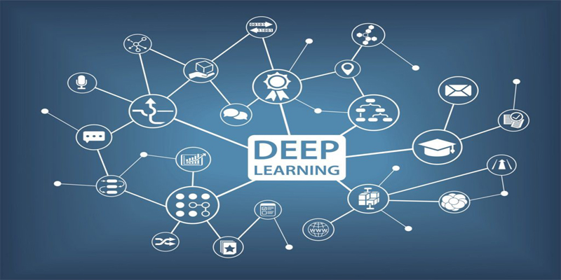

What is DEEP learning ?
Deep Learning is a definition that belongs to a part of Machine Learning algorithms with higher complexity.
Deep learning is a machine learning technique that teaches computers to do what comes naturally to humans: learn by example.
In deep learning, a computer model learns to perform classification tasks directly from images, text, or sound. Models are trained by using a large set of labeled data and neural network architectures that contain many layers.

Slide 3
BENEFITS of DEEP learning ?
Deep learning requires large amounts of labeled data. For example, driverless car development requires millions of images and thousands of hours of video.
Deep learning requires substantial computing power. High-performance GPUs have a parallel architecture that is efficient for deep learning. When combined with clusters or cloud computing, this enables development teams to reduce training time for a deep learning network from weeks to hours or less.

Slide 4
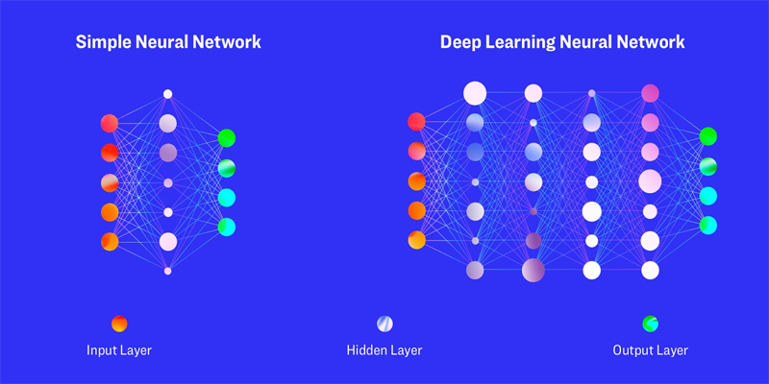
How DEEP LEArning woks Most deep learning methods use neural network architectures, which is why deep learning models are often referred to as deep neural networks. The term “deep” usually refers to the number of hidden layers in the neural network. Traditional neural networks only contain 2-3 hidden layers, while deep networks can have as many as 150.

Slide 5
One of the most popular types of deep neural networks is known as convolutional neural networks (CNN or ConvNet) A CNN convolves learned features with input data, and uses 2D convolutional layers, making this architecture well suited to processing 2D data, such as images. CNNs eliminate the need for manual feature extraction, so you do not need to identify features used to classify images. The CNN works by extracting features directly from images. The relevant features are not pretrained; they are learned while the network trains on a collection of images. This automated feature extraction makes deep learning models highly accurate for computer vision tasks such as object classification.

Slide 6
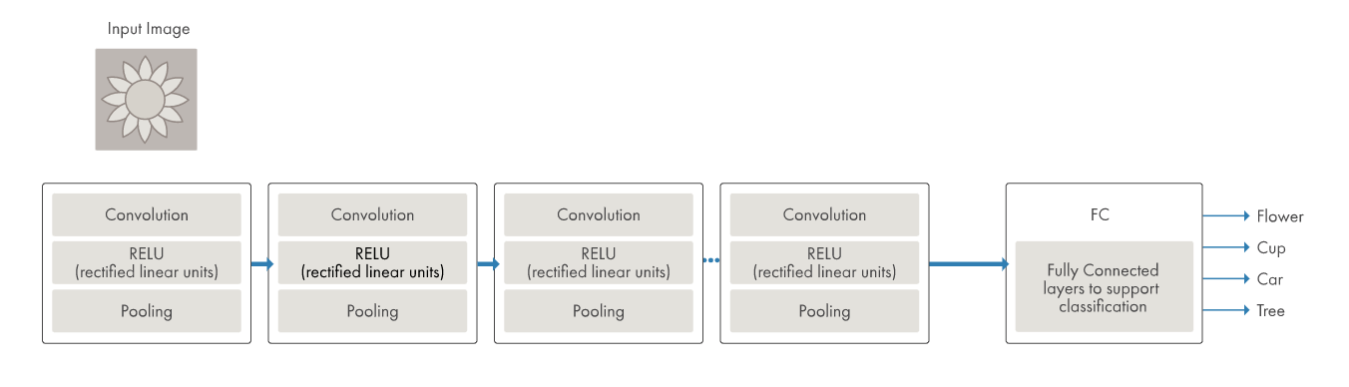
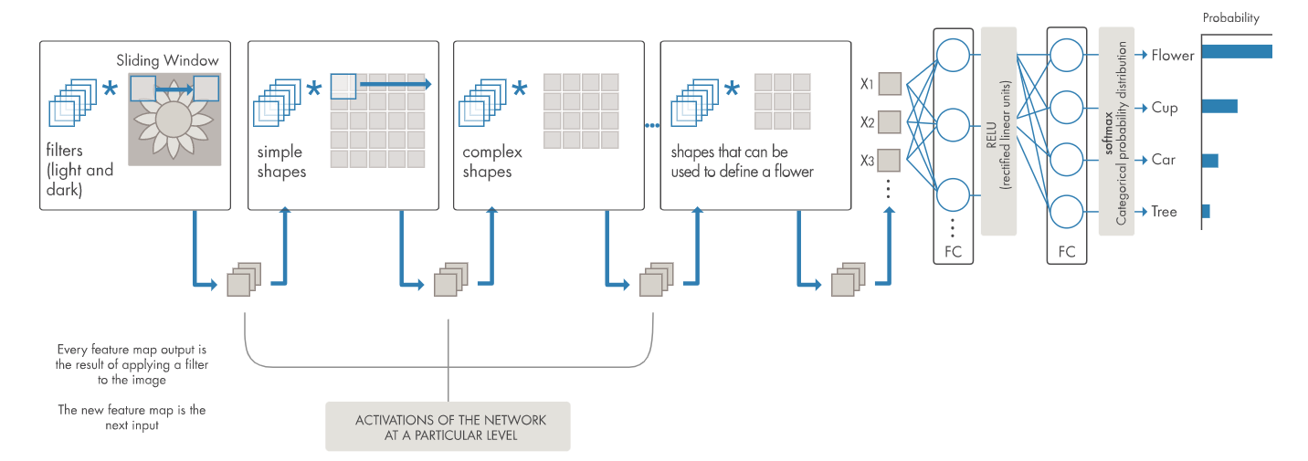
Example for cnn

Slide 8








BALANCING ACT

Slide 9

BALANCING ACT
Use this color palette when you want a balance between warm and cool. PANTONE Very Peri is intensified within this artfully calibrated palette, injecting a feeling of liveliness and visual vibration.

Slide 10







WELLSPRING

Slide 11

WELLSPRING
Use this color palette when you want a blend of nature-infused hues that highlight the compatibility of the greens and the “health giving” properties of these deliciously subtle and nourishing hues.

Slide 12







THE STAR OF THE SHOW

Slide 13
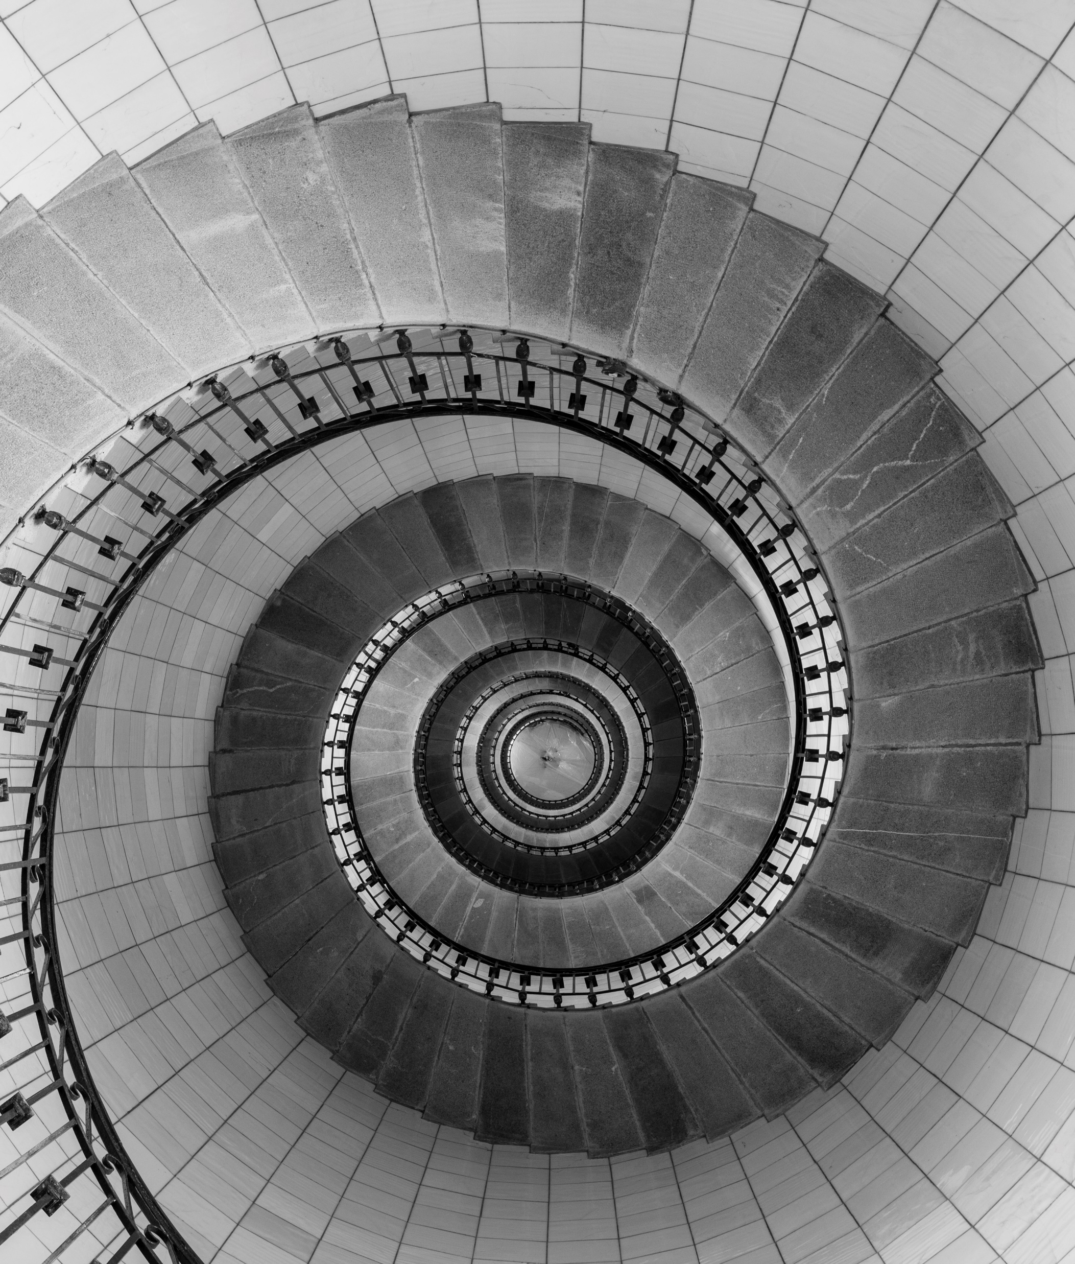
THE STAR OF THE SHOW
When you want a more elegant approach, the dynamic presence of PANTONE Very Peri shines as the star of the show in this palette of classics and neutrals whose understated stylishness conveys a message of timeless sophistication.

Slide 14







AMUSEMENTS

Slide 15

AMUSEMENTS
Use this color palette when you want to tell a joyous and whimsical story. In this palette, PANTONE Very Peri injects a sense of playful freshness into the design, exuding a good-natured warmth that quickly engages the eye.

Slide 16
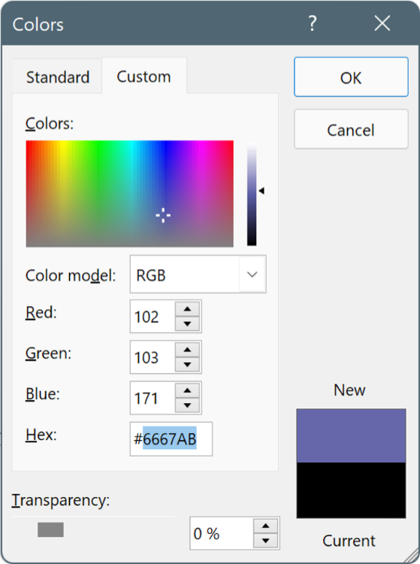
USE THESE COLORS IN ANY POWERPOINT PRESENTATION
Select a shape or text box border. When you do that, the Shape Format tab appears.
On the Shape Format tab, select Shape Fill > More Fill Colors.
In the Colors box, select the Custom tab.
Enter the Hex value of the color you want to use.
Tip: To change multiple shapes or text boxes, click the first shape or text box, and then press and hold Ctrl while you click the other shapes or text boxes.

